Slide 1
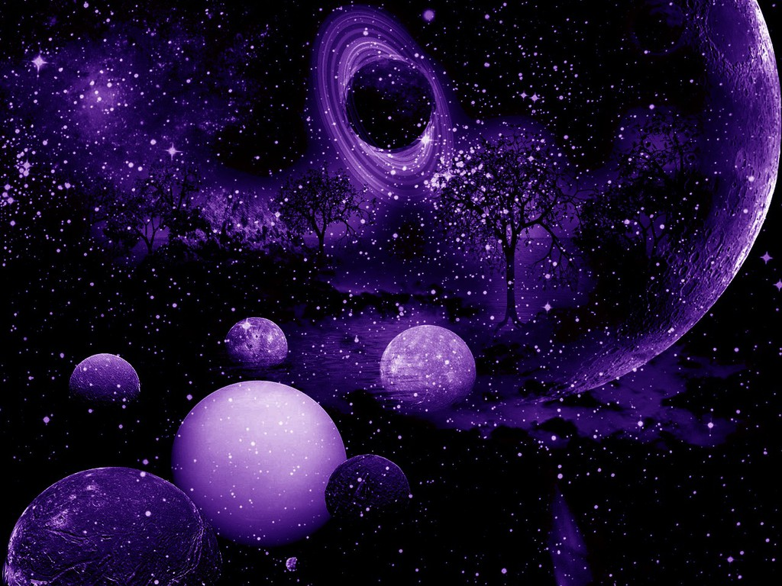
Räägime mõõtudest
Tahan rohkem teada

Slide 2
Star Size Comparison HD
https://www.youtube.com/watch?v=HEheh1BH34Q
Comparison of planets and stars
https://www.youtube.com/watch?v=Ov5AHcCQtd8
Planet & Star Size Comparison
https://www.youtube.com/watch?v=O00TDbS7dvA

